Slide 1
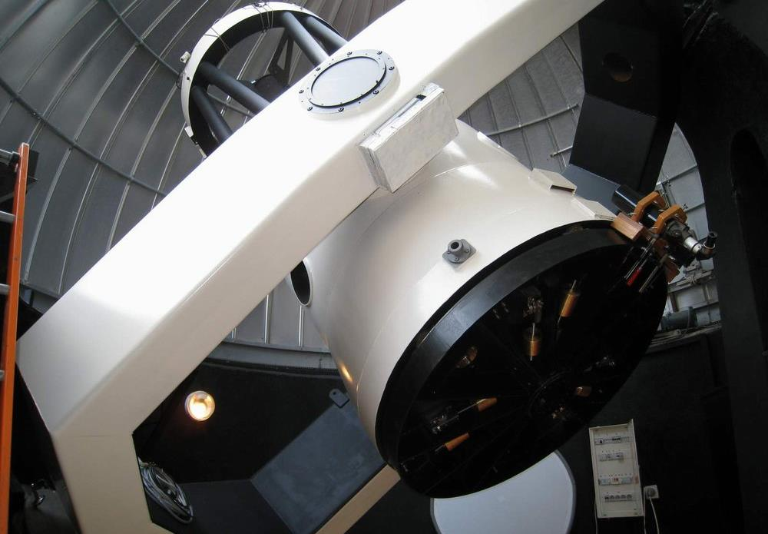


C2PU TELESCOPES
Version 02, 28/08/2016
Jean-Pierre Rivet
CNRS, OCA,
Dept. Lagrange
jean-pierre.rivet@oca.eu
© C2PU, Observatoire de la Cote d’Azur,
Université de Nice Sophia-Antipolis

Slide 2
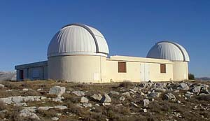
C2PU: two telescopes
West dome
Omicron telescope
East dome
Epsilon telescope
TWO 1-METER TELESCOPES
West (“Ouest” in French): omicron telescope (“omicron”: Greek leter for “O”)
East (“Est” in French): epsilon telescope (“epsilon”: Greek letter for “E”)

Slide 3
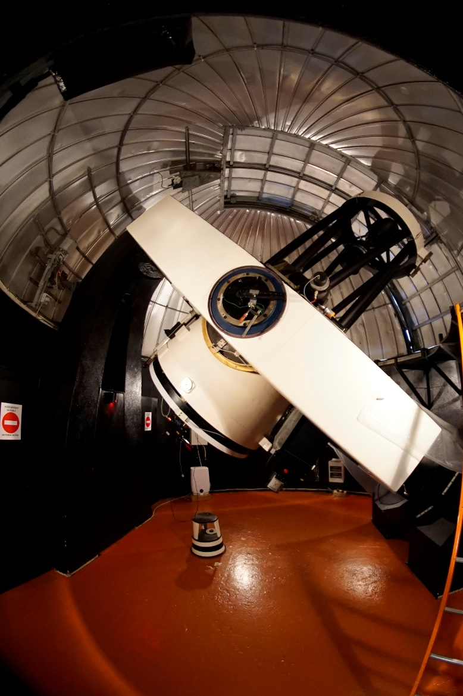
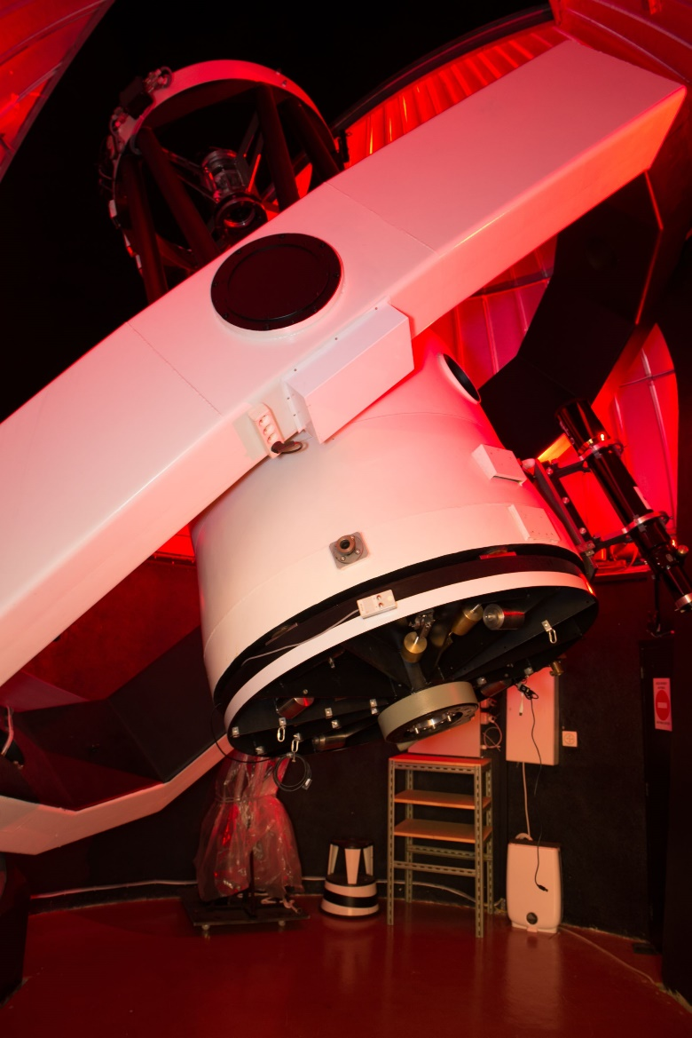
C2PU: two telescopes
Epsilon telescope
Omicron telescope

Slide 4
C2PU Telescopes : optical combinations
Cassegrain secondary focus
Secondary mirror
(hyperbolic)
Magnifies a lot
Narrow field of view
Best for planetary imaging
F 13000 mm
D = 1040 mm
F / D = 12.5
AVAILABLE
ON BOTH
TELESCOPES !
Primary mirror
(parabolic)
CCD camera
at secondary focus

Slide 5
C2PU Telescopes : optical combinations
Pure primary focus configuration
CCD camera
at primary focus
Simple, perfect at center,
BUT strong coma
aberration off-axis !
F 2995 mm
D = 1040 mm
F / D = 2.88
Primary mirror
(parabolic)

Slide 6
C2PU Telescope : optical combinations
Prime focus configuration with Wynne corrector
CCD camera
at corrected primary focus
3-lens Wynne
coma corrector
Much better !
F 3297 mm
D = 1040 mm
F / D = 3.17
Primary mirror
(parabolic)

Slide 7
How focalization is done
Prime focus configuration with Wynne corrector
All the focal assembly
(Wynne corrector + Camera)
can move up and down.
Fully motorized, computer-operated,
with position gauge
Focalization
AVAILABLE
ON OMICRON
TELESCOPE ONLY !

Slide 8
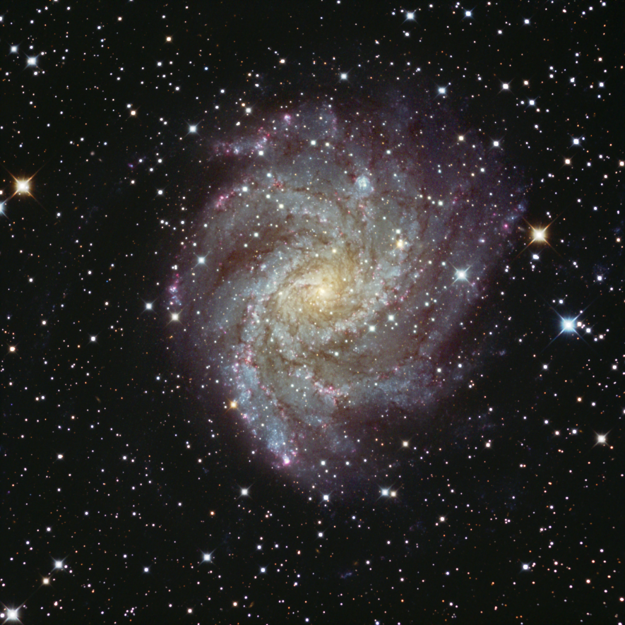
Sample image
Galaxy NGC 6946:
Distance: ≈ 10 Mly
App. size: 9.8 × 11 ‘
Telescope: omicron@C2PU
Focus: Primary + ParraCor
Camera: SBIG ST4000 XCM
Exposure: 90 x 2mn
Date: 14/09/2012
Author: David Vernet

Slide 9

C2PU Telescopes : optical combinations
Celestial North pole
“Coudé” focus
4th mirror
(flat)
Secondary mirror
(hyperbolic)
Polar axis
CCD camera
at coudé focus
Magnifies a lot
Very narrow field of view
Fixed focus
Best for “big” focal sensors
Optical bench
3rd mirror
(flat)
AVAILABLE
ON EPSILON
TELESCOPE ONLY !
F = 36400 mm
D = 1040 mm
F / D = 35
5th mirror
(flat)
Primary mirror
(parabolic)

Slide 10
Optical configurations
Prime focus +
Wynne corrector
F/3.2:
Photometry,
Astrometry,
Occultations.
Wide field imaging.
Coudé focus F/35
Only for invited
instruments
West dome
Omicron telescope
East dome
Epsilon telescope
Cassegrain focus
F/12.5 or F/9.0
(with focal reducer):
Spectroscopy,
Narrow field imaging.
Cassegrain focus
F/12.5 or F/9.0
(with focal reducer)
Spectroscopy,
Narrow field imaging.

Slide 11
C2PU Telescopes : equatorial yoke mount
Yoke mount “pros and cons” :
Very stable mechanically
Low flexion
Limitations in accessible
sky zone (blind angles).
... More on that later.
Polar axis
H
δ
North pillar
Telescope’s tube
(Serrurier structure)
Yoke
Declination axis
South pillar

Slide 12
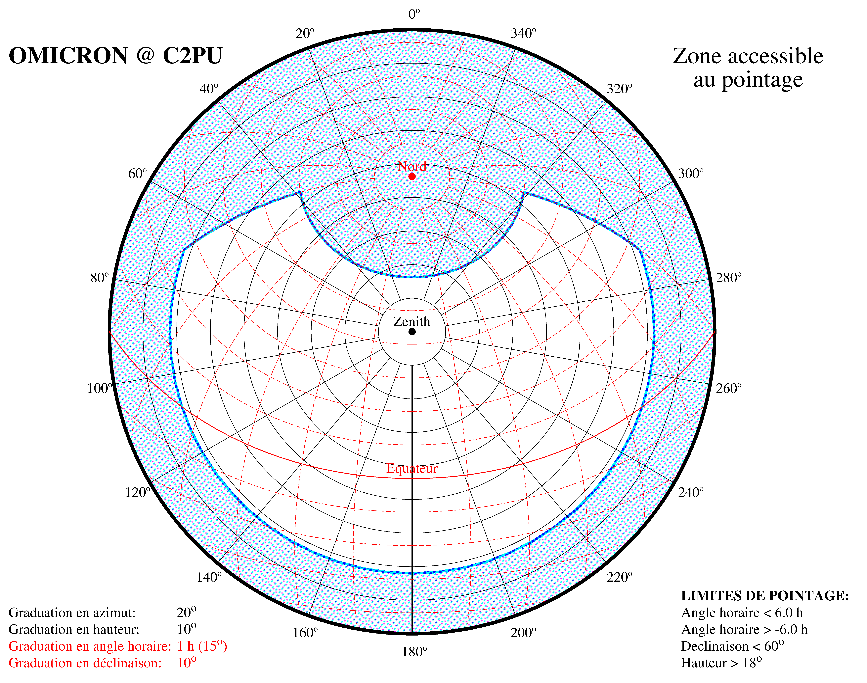
Omicron Telescope : accessible zone
Elevation:
h > 18°
Declination:
< 60°
Hour angle:
-6^{h} < H < +6^{h}

Slide 13
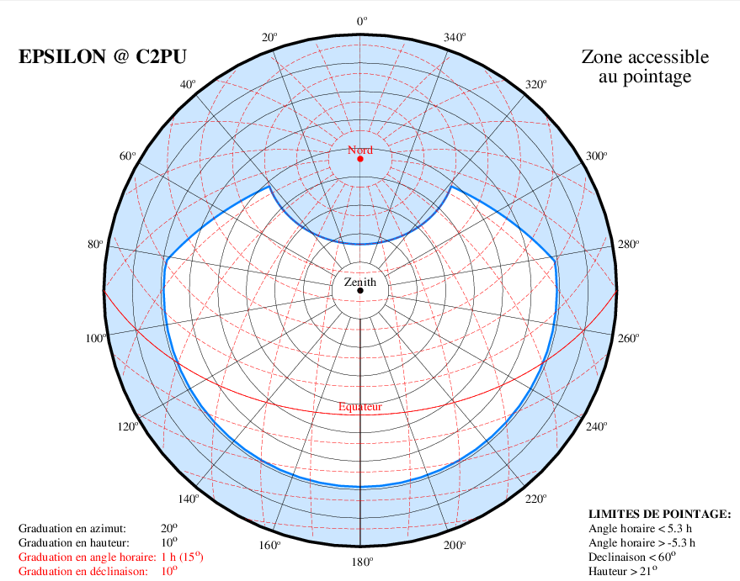
Epsilon Telescope : accessible zone
Elevation:
h > 21°
Declination:
< 60°
Hour angle:
-5.3^{h} < H < +5.3^{h}

Slide 14
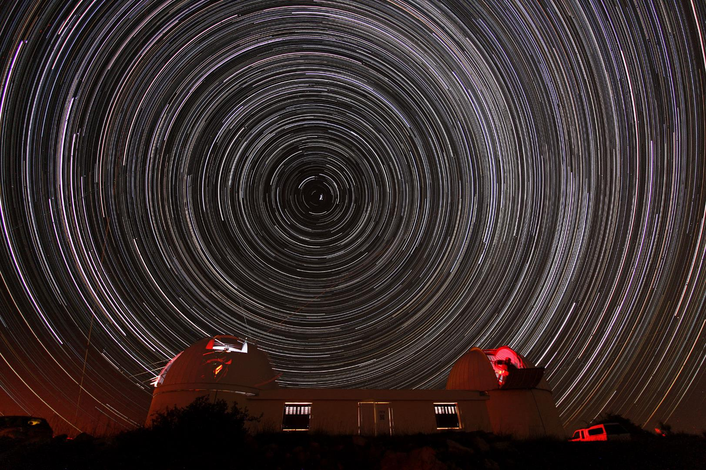
ENJOY !

